Slide 1
Union Grove Middle School
2022-2023
Comprehensive School
Counseling Plan
Ms.Blake, Mrs. Mullvain & Ms. Richards

Slide 2
VISION
Union Grove Middle School’s Counseling Department is committed to empowering our Wolverines to become confident and resilient leaders who exceed Above and Beyond expectations.
Notes:
Gullatt

Slide 3
Mission
The Union Grove Middle School Counseling Program is dedicated to promoting the health and wellness of all students by providing a comprehensive program which is aligned to the American School Counseling National Model. Services provided include:
Core curriculum lessons
Responsive services
Small group counseling (needs based)
College and career readiness
Schoolwide initiatives (You Matter, Red Ribbon Week, Kindness Week, etc.)
Community education
Notes:
Gullatt

Slide 4
Belief Statements
School Counselors at Union Grove Middle School believe:
All students have the ability to meet or exceed academic standards in each grade level.
All students benefit from the implementation of an effective Comprehensive School Counseling Plan.
School Counselors are leaders who are responsible for advocating for all students and promoting student achievement.
Notes:
Gullatt

Slide 5
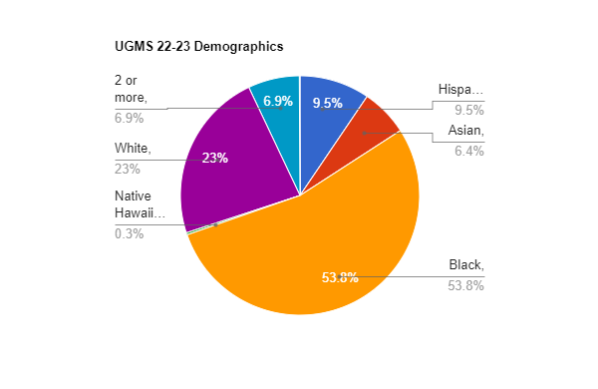
Union Grove Middle School 2022-2023 Demographics
6th grade: 355
7th grade: 352
8th grade: 358
Total - 1065
Notes:
Lawson

Slide 6
Union Grove Middle School Needs Assessment Results Sept. 2022
Top 3 Responses:
I need help improving my studying and test taking skills. 50%
I need help reducing test anxiety. 37%
I need help dealing with I need help exploring future careers. 34%
Notes:
Lawson

Slide 7
UGMS CSCP Aligned with HCS
District Strategic Plan
District Priority Outcome #2: We will advance opportunities, access, and outcomes for every student group in Readiness to Learn at every level.
3. Students demonstrating social and emotional health and readiness
Strategic Action #4: Advance student and employee health, wellness, and support structures.
4. Develop a continuum of services to ensure that every student is learning in a safe and healthy environment.

Slide 8
Goal #1 for the 2022-2023 School Year
Social Emotional/Behavioral
By the end of the current school year, the number of students serving In School Suspension (ISS) will decrease by 5%. (Based off data from the 2018 - 2019 (pre-COVID)school year (224 students) to the 2022-2023 school year (212 or fewer students).
(Tier 1) Core curriculum lessons - Managing Emotions and Effective Communication.
(Tier 2 & 3): Check-ins (weekly, bi-weekly, or monthly); small group interventions; teacher input

Slide 9
UGMS CSCP Aligned with HCS
District Strategic Plan
District Priority Outcome #3: We will advance opportunities, access, and outcomes for every student group in College, Career, and Life Ready skills-post graduation.
Students Completing Career Inventories, Internships/Apprenticeships, and Industry Certifications
Students Demonstrating Financial Literacy, Soft Skills, and ESE Students Mastering IEP Transition Goals)
Participation in and Performance on PSAT
Strategic Action #4: Advance PreK-12 learning opportunities and experiences for all students.
Establish a comprehensive school-wide counseling, academic, and career coaching, and advisement program.

Slide 10
Goal # 2 for the 2022-2023 School Year
Career Planning
By the end of the current school year, 95% of 6th-8th grade students complete all required Bridge Bill tasks.
(Tier 1) Core Curriculum Lessons (Naviance), Information shared with parents (website, parent nights)
(Tier 2 & 3): Follow up with incoming students; ensure students complete surveys to mark task as completed.

Slide 11
UGMS CSCP Aligned with HCS
District Strategic Plan
District Priority Outcome #3: We will advance opportunities, access, and outcomes for every student group in College, Career, and Life Ready skills-post graduation.
Students Completing Career Inventories, Internships/Apprenticeships, and Industry Certifications
Students Demonstrating Financial Literacy, Soft Skills, and ESE Students Mastering IEP Transition Goals)
Participation in and Performance on PSAT
Strategic Action #1: Advance PreK-12 learning opportunities and experiences for all students.
Increase exploration of, access to, and participation in advanced content coursework and experiences.

Slide 12
Goal #3 for the 2022-2023 School Year
Academic
By the end of the current school year, we will increase the number of students expected to enroll in at least one advanced course from a baseline of 12%
(18/19sy - 21/22sy) to 15% in 22-23sy.
(Tier 1):
Provide additional opportunities for advanced coursework.
Communicate with UGHS to ensure course offerings align with available pathways at UGHS.
Core Curriculum lessons informing students of opportunities for advanced level coursework and high school graduation requirements.
Providing communication to parents about advanced level coursework.
(Tier 2 & 3): Identify incoming students that would be eligible to take advance coursework by reviewing MAP scores, Georgia Milestones, and grades

